Slide 1
call center
File created on: 13-Jun-22 8:32:34 PM

Slide 2
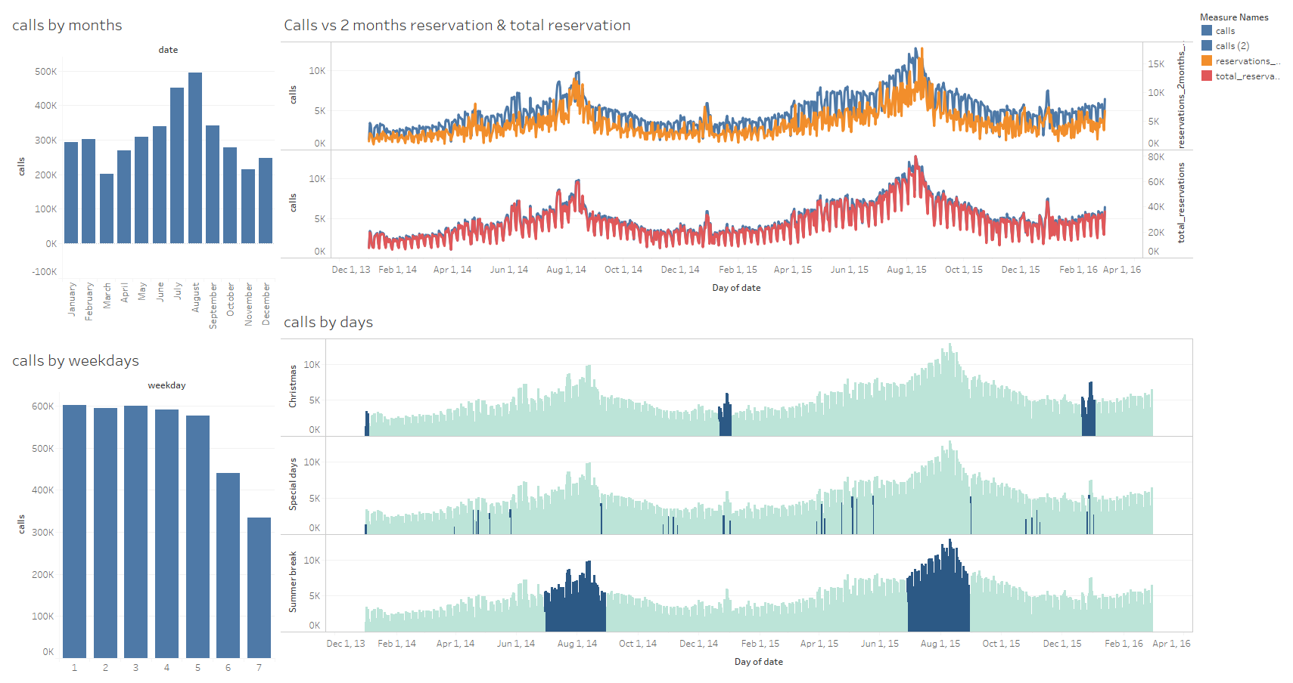

Slide 3

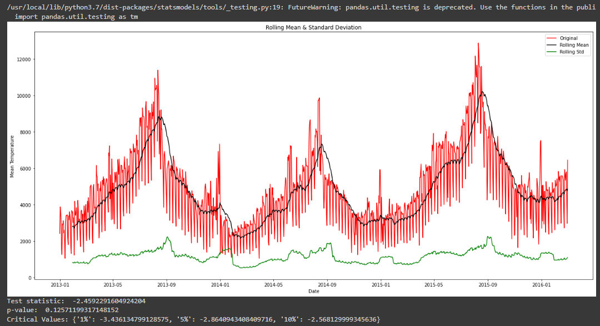
Call volume forecasting by ARIMA(p,d,q) model
First Step: check stationarity by Adfuller-test
The p-value obtained is greater than significance level of 0.05 and the ADF statistic is higher than any of the critical values.
Mean is no stationary (Black line)
Std is stationary (Green line)
***This time series is non-stationary
https://colab.research.google.com/drive/1chOjNVLhUhqeWI6FQjJMP3MMtwEEq7Yv?usp=sharing

Slide 4
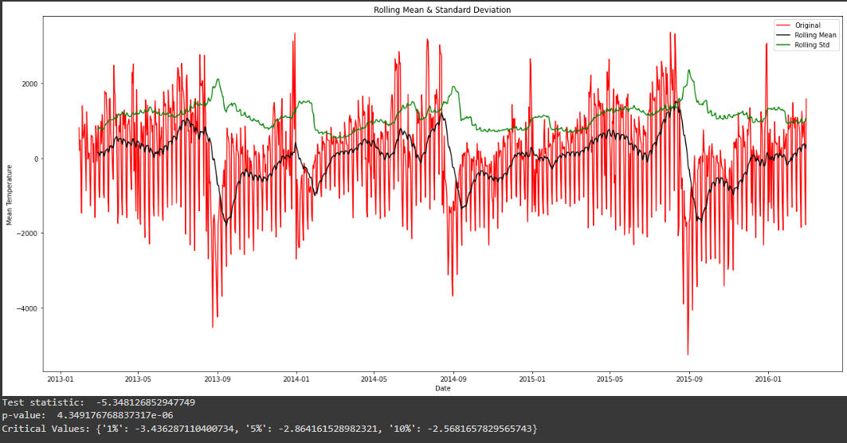
Next, transform the mean to stationary
Use the Moving average method to remove trend
Then, check the Adfuller-test again.
The test statistic is smaller than the 1% critical values so we can say with 99% confidence that this is a stationary series now.

Slide 5
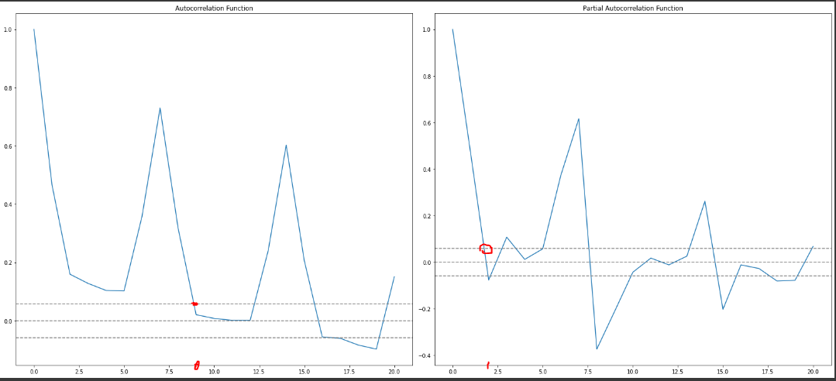
Then, calculate the (p,d,q) parameters for ARIMA model
Use Autocorrelation function to calculate p
Use Partial Autocorrelation function to calculate q
Choose q and p based on ACF and PACF chart where the lag value crosses the upper confidence interval for the first time.
Therefore, ARIMA(9,0,2) model
***d = 0 as we didn’t apply any differencing on the dataset to achieve stationary.

Slide 6
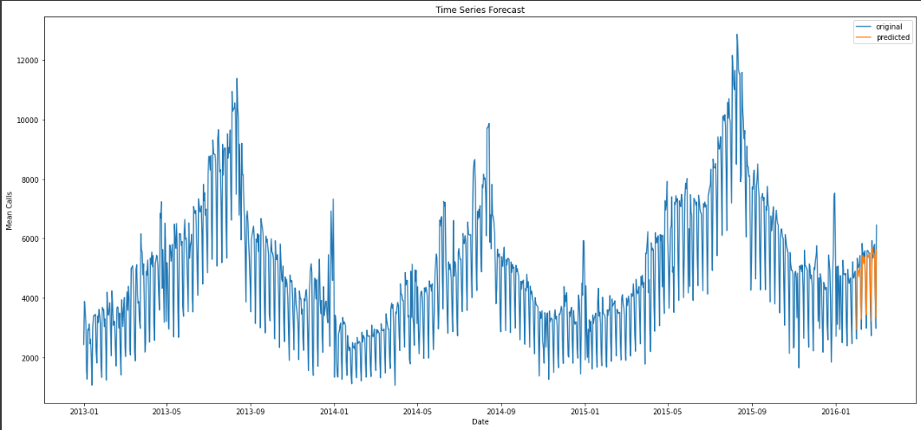
Result

Slide 7
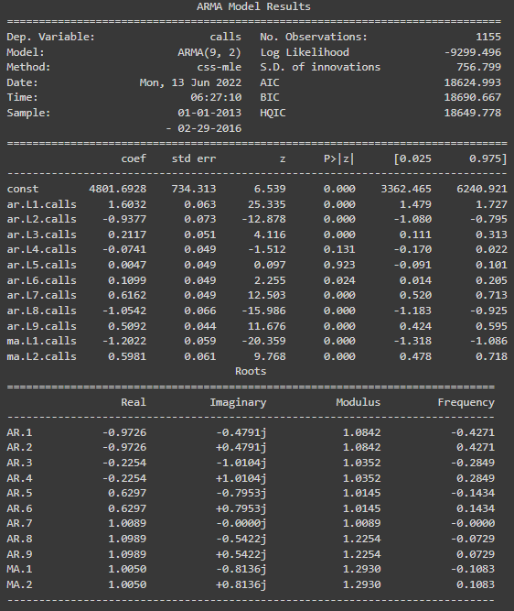
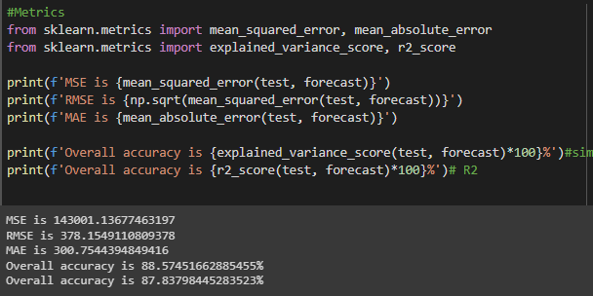
Result
Based on ARIMA(9,0,2), it achieve around 88% accuracy in terms of forecasting the calls volume.

Slide 8
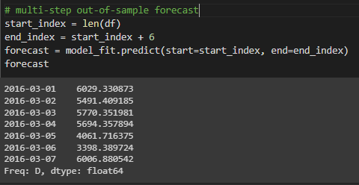

Headcount Planning (ErLang C method)
Assumption:
Average handle time (AHT) = 3 mins
Interval: 10hrs*60 mins = 600 mins
Average speed of answer (ASA) = 20secs
Shrinkage = 30% (time of server not available)
Forecast headcount for next week:
#{'raw_positions': 38, 'positions': 55, 'service_level': 0.9506284601132141, 'occupancy': 0.7932894736842107, 'waiting_probability': 0.1181732679952054}
#{'raw_positions': 35, 'positions': 50, 'service_level': 0.9493550463023026, 'occupancy': 0.7844285714285715, 'waiting_probability': 0.11711694063207706}

